Slide 1

Employee Management System
Leveraging SQL for insightful HR data analysis
BY
Bhavana golla

Slide 2
About me
Background ? (B-tech, Computer Science and Engineering)
Why you want to learn Data Science: I am very Passionate about using data to uncover insights and drive business decisions.
Linkedin :https://www.linkedin.com/in/bhavanagolla
Github :https://github.com/GollaBhavana7

Slide 3

Agenda
Objective of the Project
ER Diagram and schema explanation
Key analysis questions (use cases)
SQL query results with screenshots or summaries
Final business insights and recommendations
Conclusion (Key finding overall)
Q&A Slide
Your Experience/Challenges working on SQL – Data Analysis Project.

Slide 4
Problem Statement
Managing employee information manually often leads to data redundancy, inconsistency, and difficulty in tracking records.
Organizations face challenges in maintaining accurate details of job roles, salaries, leaves, and qualifications.
A centralized system is required to ensure data integrity, easy access, and efficient HR operations.

Slide 5
Objective
The project aims to design and implement an Employee Management System using relational tables with foreign keys.
It will store and manage employee details, salaries, payroll, and leave records efficiently.
The system will provide accurate payroll calculations, leave tracking, and department-specific insights to streamline HR tasks.

Slide 6
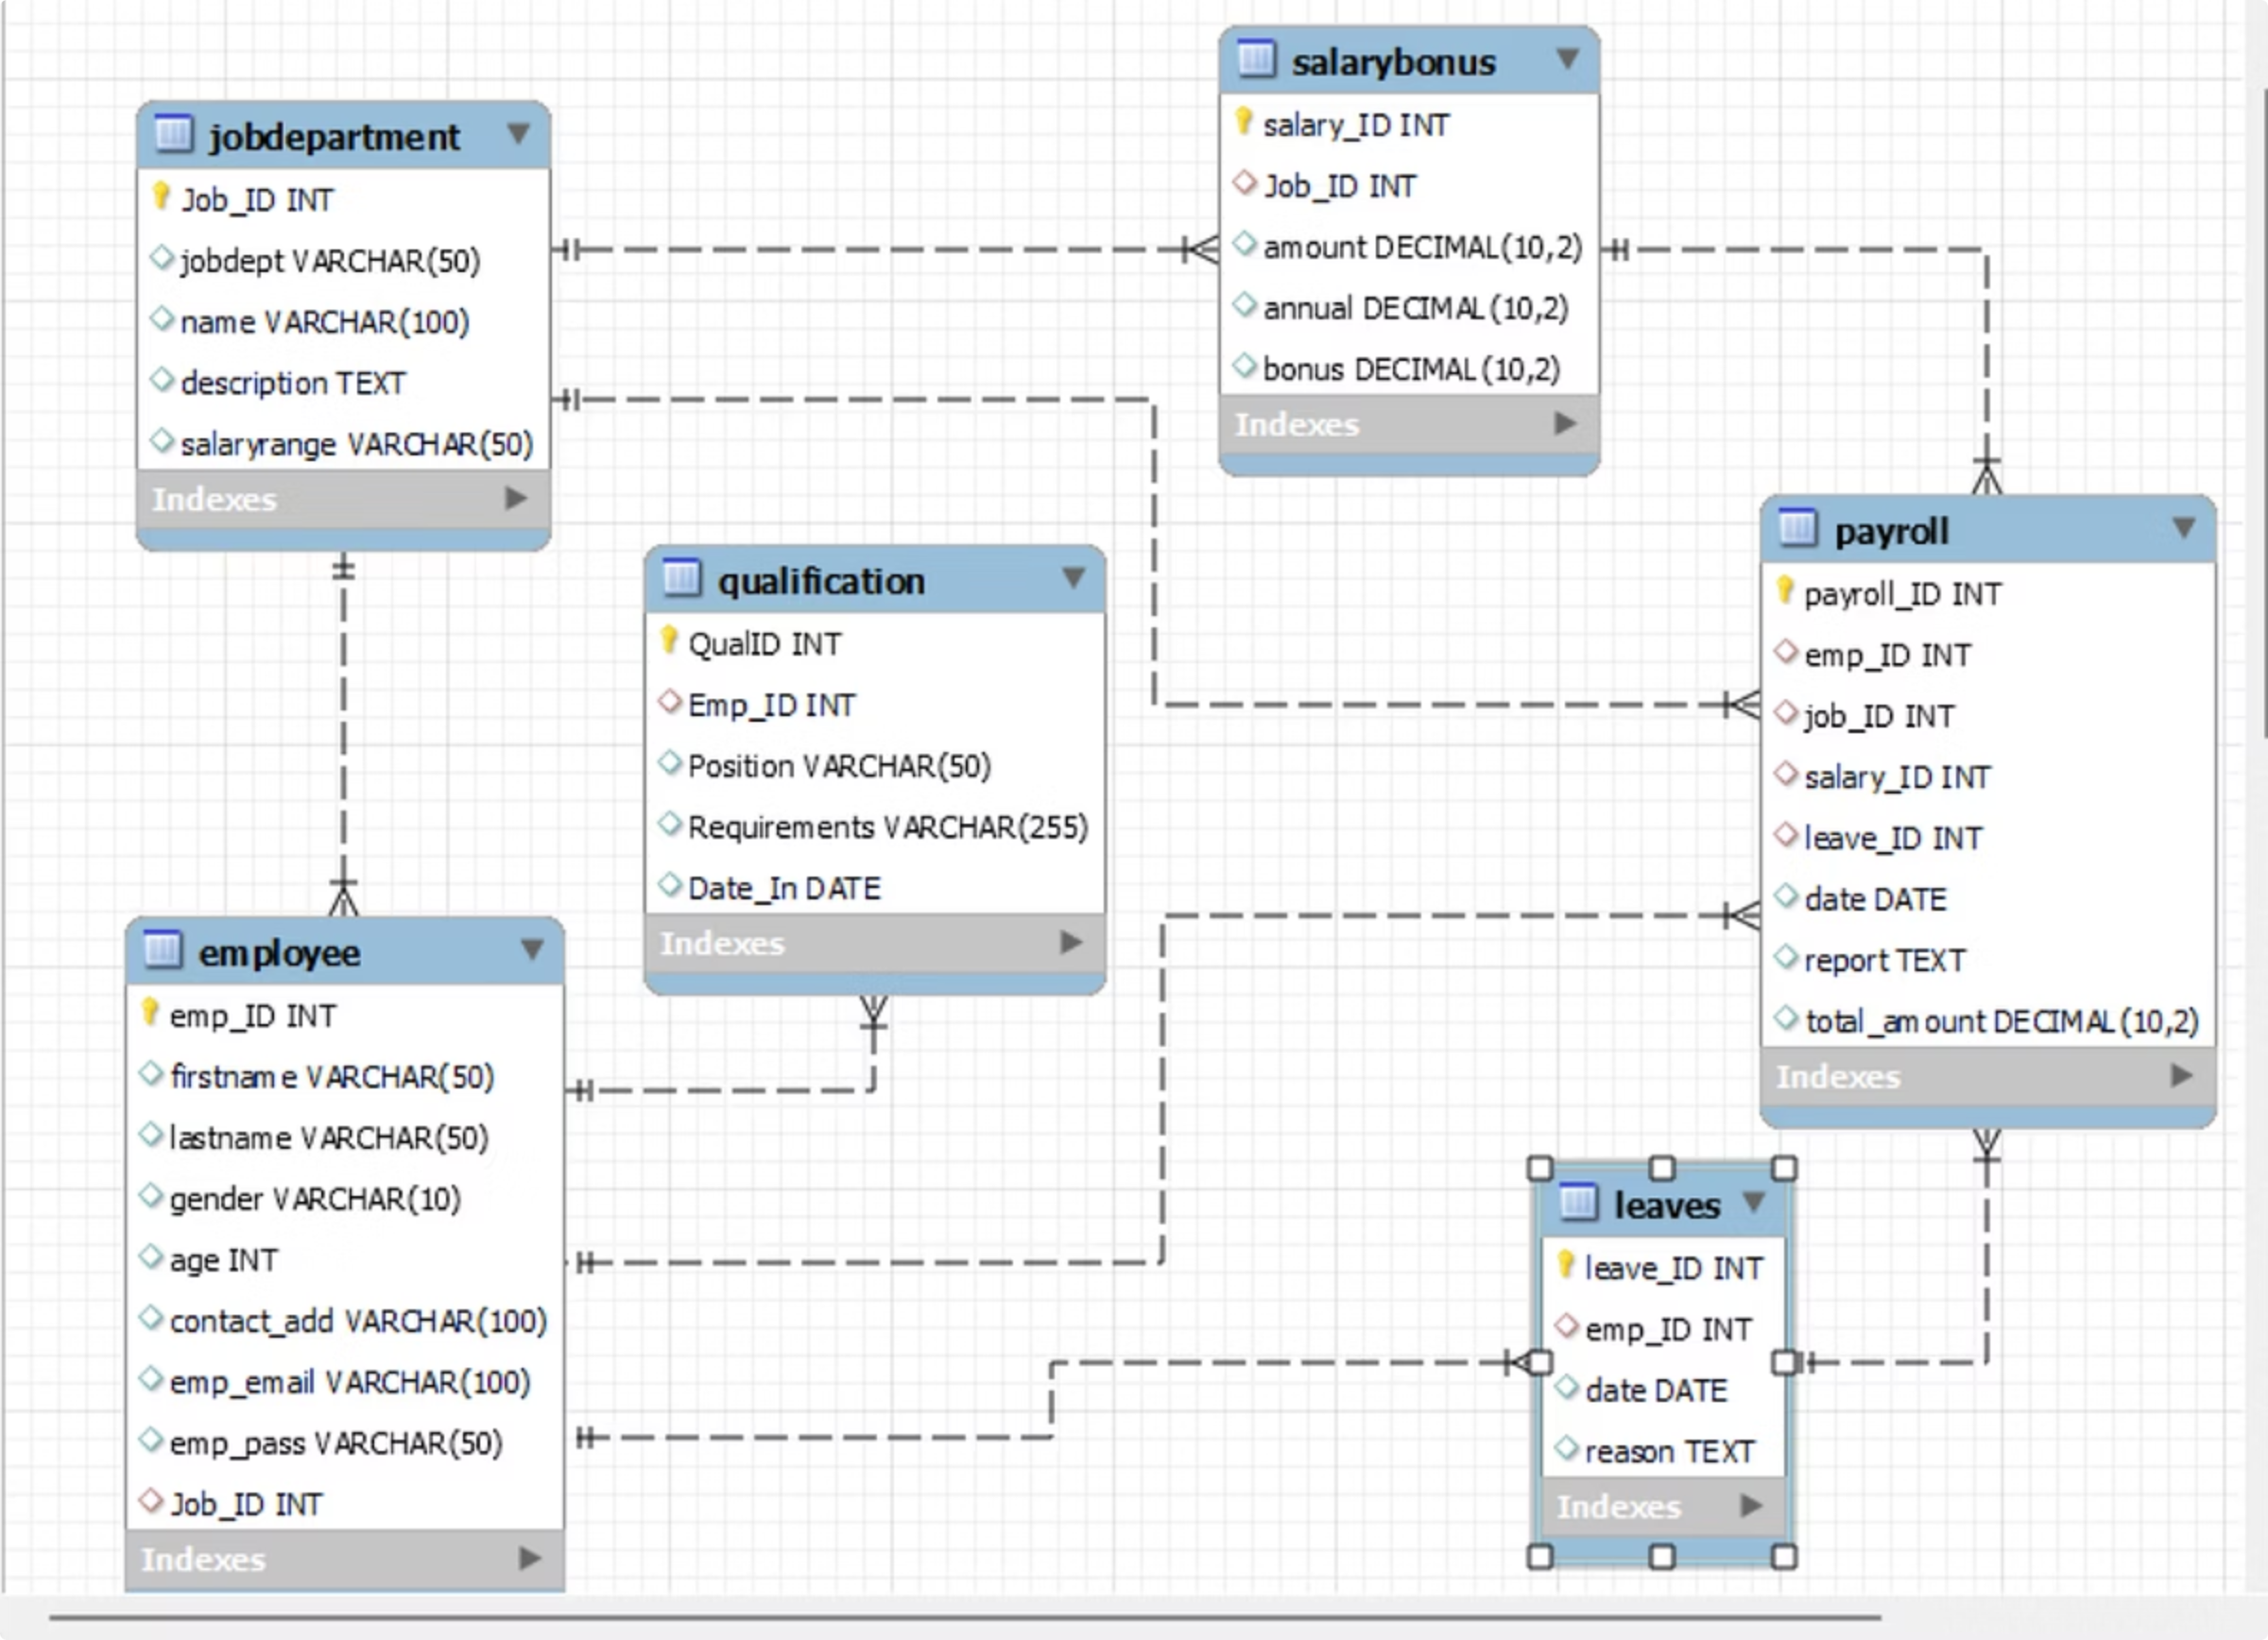
ER Diagram
The system is built on core entities that store primary information about each Employee and their Job Department.
It tracks an employee's history and events over time through related tables for Qualifications and Leaves.
Finally, the Payroll table acts as a central hub, integrating all this data to process payments and create transactional records.

Slide 7

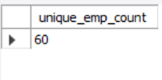
1. EMPLOYEE INSIGHTS How many unique employees are currently in the system?
INSIGHTS:
The organization currently has 60 unique employees recorded in the system.
This provides a clear baseline of workforce size for HR management and further analysis of payroll, leaves, and departmental distribution.

Slide 8
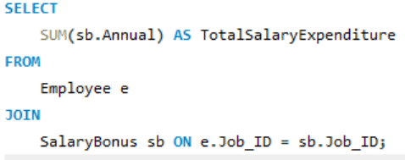
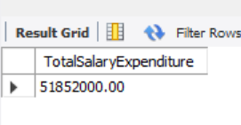
What is the total salary expenditure across the company?
INSIGHTS:
The company’s total annual salary expenditure is 51.85 million.
This figure highlights the scale of financial commitment towards employee compensation, making it a crucial metric for budgeting and workforce planning.

Slide 9
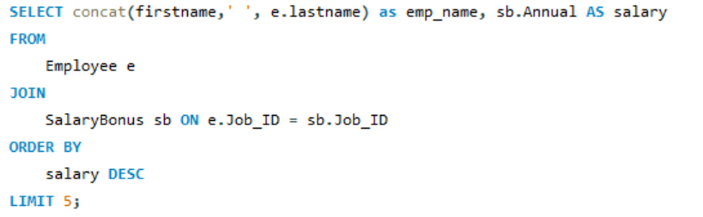
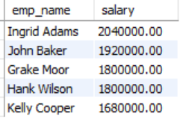
Who are the top 5 highest-paid employees?
INSIGHTS:
Ingrid Adams is the highest-paid employee with an annual salary of ₹20,40,000, followed by John Baker at ₹19,20,000.
The top 5 highest-paid employees earn between ₹16.8 lakh and ₹20.4 lakh annually, showing a narrow gap among senior earners.

Slide 10
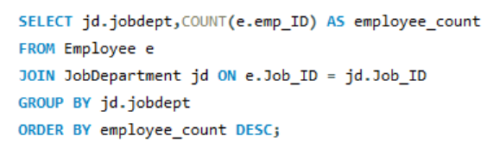
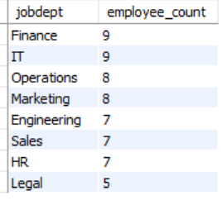
Which departments have the highest number of employees?
Insight:
The Finance and IT departments have the highest number of employees (9 each).
Operations and Marketing follow closely with 8 employees each, while Legal has the least with 5 employees.
This distribution shows a strong focus on Finance and IT functions within the organization.

Slide 11
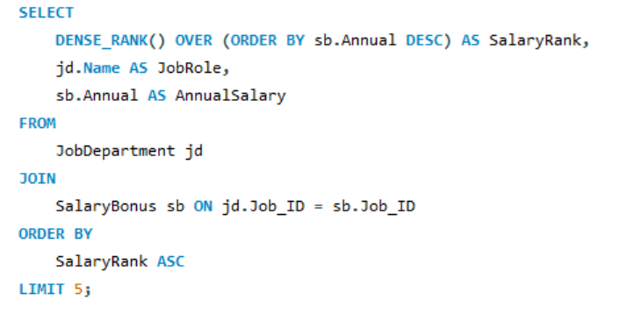
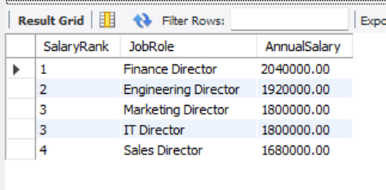
2. JOB ROLE AND DEPARTMENT ANALYSIS
Which job roles offer the highest salary?
INSIGHTS:
The Finance Director role offers the highest annual salary (2.04M), followed by the Engineering Director (1.92M).
Director-level positions across Finance, Engineering, Marketing, IT, and Sales are among the top-paid roles, reflecting their strategic importance to the organization.

Slide 12
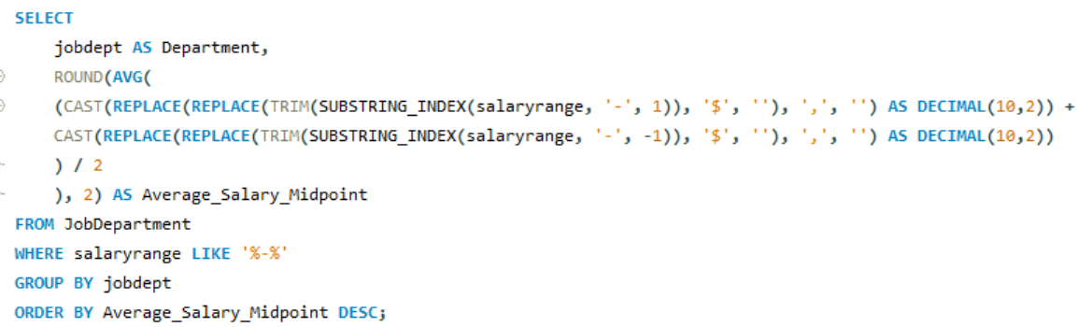
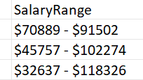
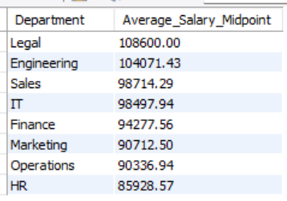
What is the average salary range per department?
INSIGHT:
Salaries are highest in Legal and Engineering, reflecting the high value of specialized expertise, while Sales and IT remain competitive.
Finance and Marketing occupy the mid-range, whereas Operations and HR are positioned at the lower end of the pay scale.

Slide 13
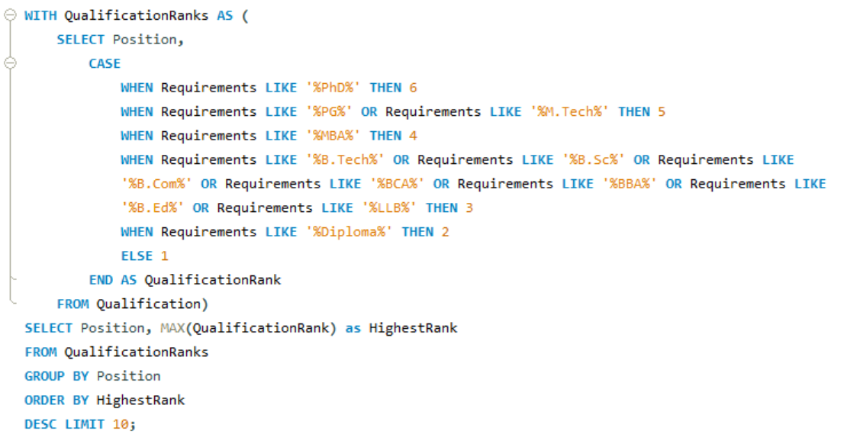
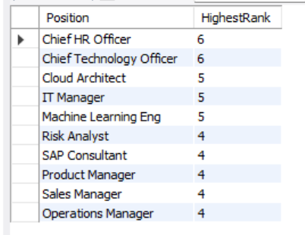
3. QUALIFICATION AND SKILLS ANALYSIS
Which positions require the most qualifications?
INSIGHTS:
Chief HR Officer & CTO require the highest qualifications (PhD). Tech roles (Cloud Architect, IT Manager, ML Engineer) demand PG degrees, while most managerial roles need MBA/B.Tech.

Slide 14


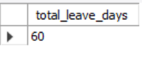
4. LEAVE AND ABSENCE PATTERNS
What is the total number of leave days taken company-wide?
INSIGHTS:
Across the company, employees have collectively taken 60 leave days
This provides HR with a clear picture of the organization’s total absence impact and helps in evaluating leave policies and workforce availability.

Slide 15
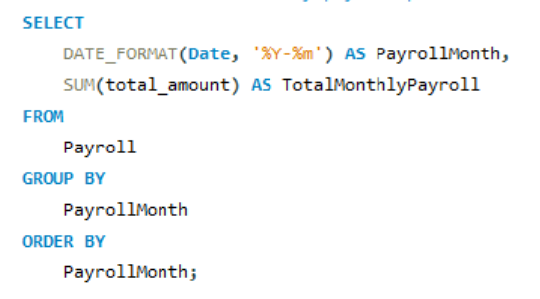
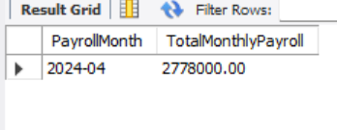
5. PAYROLL AND COMPENSATION ANALYSIS
What is the total monthly payroll processed?
INSIGHT:
In April 2024, the company processed a total payroll amount of 2.78 million.
This highlights the monthly financial outflow towards employee compensation, essential for budget tracking and financial planning.

Slide 16
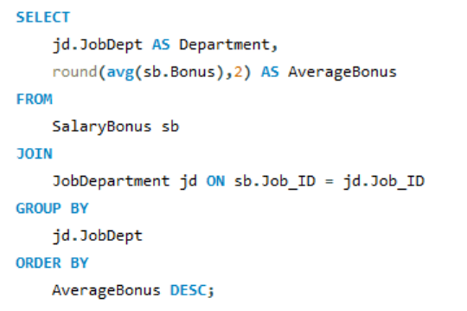
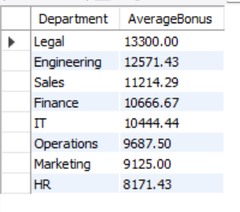
What is the average bonus given per department?
INSIGHTS:
The Legal department received the highest average bonus (13.3K).
The HR department received the lowest average bonus (8.1K).
There’s a 5,000+ difference between the top and bottom departments, showing variation in performance-linked or role-based incentives.

Slide 17
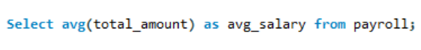

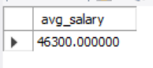
What is the average value of total amount after considering leaves deductions?
INSIGHTS:
The computed average salary from payroll records is ₹46,300, reflecting actual payouts after leave deductions.
This indicates that leave-related salary cuts bring the overall average pay to this level.

Slide 18
CONCLUSION
This project helped us gain practical knowledge of using SQL to manage and analyze data from an employee management system.
We explored workforce patterns, departmental salary variations, and roles that demand higher qualifications.
SQL enabled us to handle large datasets efficiently and transform them into valuable insights for organizational decision-making.
It also highlighted how employee data can support activities like HR planning, promotions, performance reviews, and resource allocation.
Overall, this project provided hands-on experience in database handling as well as data analysis for improving business operations.

Slide 19
Final Business Insights and Recommendations
Legal and Engineering departments provide higher salaries, reflecting their strategic importance.
Leadership and technical roles require advanced qualifications for career progression.
Some roles offer good pay with fewer qualifications, highlighting opportunities for talent development.
Employee distribution shows the need for better workforce balancing across departments.
Promotions indicate that career growth is driven by both skills and performance.
Organizations should focus on retention, fair pay, advanced learning support, and transparent career paths.

Slide 20
EXPERIENCE AND CHALLENGES
Gained strong hands-on experience in writing SQL queries to extract, clean, and analyze large datasets.
Learned how to apply different SQL concepts like joins, group by, subqueries, and CTEs to answer real-world business questions.
Faced challenges in handling inconsistent or missing data from CSV files and ensuring data accuracy after loading into the database.
Writing optimized queries for complex problems was difficult initially but improved with practice.
Interpreting the results into meaningful business insights required both technical and analytical thinking.
Improved understanding of database design, query performance, and how structured data can drive business decisions.

Slide 21
Q & A

Slide 22


THANK YOU

